Slide 1








CSS 3 – Overview
What is new in CSS 3?
Nikolay Kostov
Telerik Corporation
www.telerik.com

Slide 2


Table of Contents
What is CSS 3?
Selectors
Fonts
Colors
Backgrounds
Borders
Box Model
Animations

Slide 3
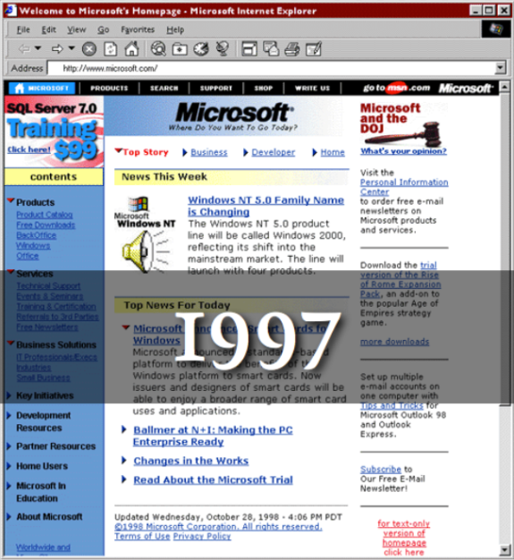

What is CSS 3?

Slide 4

What is CSS 3?
Cascading Style Sheets level 3 is the most recent iteration of CSS
It is divided into several separate documents called "modules"
CSS 3 has not been approved as a specification, but there are already a lot of properties that are supported in various browsers.
The earliest CSS 3 drafts were published in June 1999

Slide 5

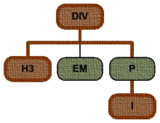

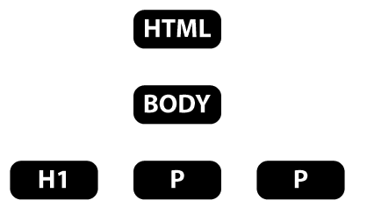

Selectors

Slide 6

Attribute Selectors
E[foo^="bar"]
An E element whose "foo" attribute value begins exactly with the string "bar"
Example: a[src^="https://"]
E[foo$="bar"]
An E element whose "foo" attribute value ends exactly with the string "bar"
E[foo*="bar"]
An E element whose "foo" attribute value contains the substring "bar"

Slide 7

Attribute Selectors
Live Demo

Slide 8
Structural Pseudo-classes
:root
The root of the document
E:nth-child(n)
An E element, the n-th child of its parent
E:nth-last-child(n)
An E element, the n-th child of its parent, counting from the last on
E:nth-of-type(n)
An E element, the n-th sibling of its type

Slide 9
Structural Pseudo-classes (2)
E:nth-last-of-type(n)
An E element, the n-th sibling of its type, counting from the last one
E:last-child
An E element, last child of its parent
E:first-of-type
An E element, first sibling of its type
E:last-of-type
An E element, last sibling of its type

Slide 10
Structural Pseudo-classes (3)
E:only-child
An E element, only child of its parent
E:only-of-type
An E element, only sibling of its type
E:empty
An E element that has no children (including text nodes)
More detailed descriptions:
http://www.w3.org/TR/css3-selectors/#structural-pseudos

Slide 11

Structural Selectors
Live Demo

Slide 12
The UI Element States Pseudo-classes
E:enabled
A user interface element E which is enabled
E:disabled
A user interface element E which is disabled
E:checked
A user interface element E which is checked (for instance a radio-button or checkbox)
Currently supported only in Opera!

Slide 13
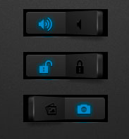
UI Selectors
Live Demo

Slide 14
Other CSS 3 Selectors
E:target
An E element being the target of the referring URI
E:not(s)
An E element that does not match simple selector
E ~ F
An F element preceded by an E element

Slide 15

Other CSS 3 Selectors
Live Demo

Slide 16


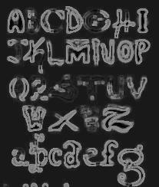

Fonts

Slide 17

Font Embeds
Use @font-face to declare font
Point to font file on server
Call font with font-family
Currently not supported in IE
Use font embedding instead of images
@font-face {
font-family: SketchRockwell;
src: url('SketchRockwell-Bold.ttf');
}
.my_CSS3_class {
font-family: SketchRockwell;
font-size: 3.2em;
}

Slide 18


Text Shadow
Applies shadow to text
Syntax: text-shadow: <horizontal-distance> <vertical-distance> <blur-radius> <shadow-color>;
Do not alter the size of a box
text-shadow: 2px 2px 7px #000000;

Slide 19


Text Overflow
Specifies what should happen when text overflows the containing element
Syntax: text-overflow: <value>;
Possible values:
ellipsis - Display ellipses to represent clipped text
clip - Default value, clips text
Currently not supported in Firefox and IE

Slide 20
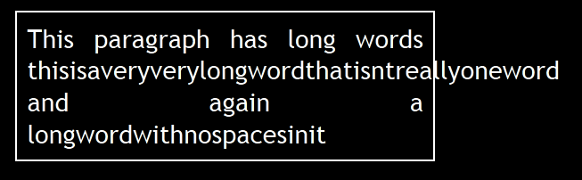
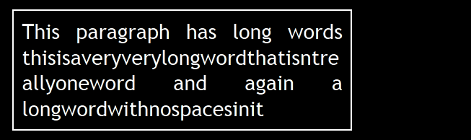
Word Wrapping
Allows long words to be able to be broken and wrap onto the next line
Syntax: word-wrap: <value>;
Possible values:
normal
break-word
Supported in all major browsers

Slide 21
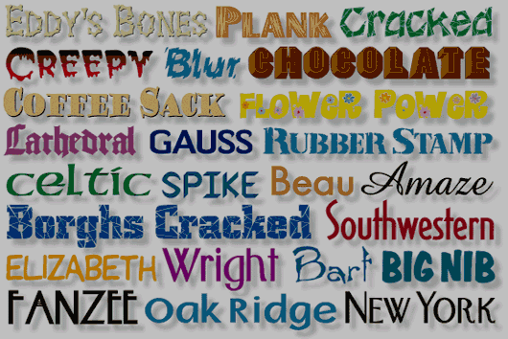
CSS 3 Fonts
Live Demo

Slide 22

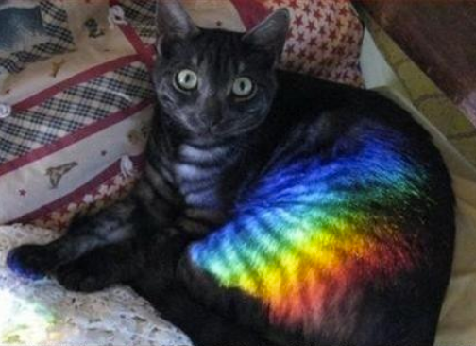
Colors

Slide 23



Opacity
Sets the opacity level for an element
Syntax: opacity: <value>;
Value from 0.0 (fully transparent) to 1.0
The opacity is supported in all major browsers.
Note: IE8 and earlier supports an alternative, the filter property: filter: Alpha(opacity=50).
Example:
<img src="img.jpg" style= " opacity: 0.4; filter: alpha(opacity=40)" />

Slide 24


RGBA Colors
Standard RGB colors with an opacity value for the color (alpha channel)
Syntax: rgba(<red>, <green>, <blue>, <alpha>)
The range for red, green and blue is between integers 0 and 255
The range for the alpha channel is between 0.0 and 1.0
Example: rgba(255, 0, 0, 0.5)

Slide 25
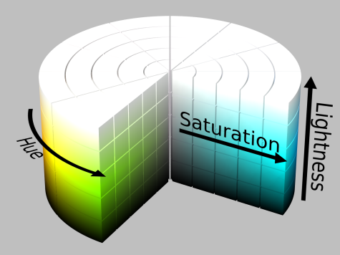
HSL Colors
Hue is a degree on the color wheel
0 (or 360) is red, 120 is green, 240 is blue
Saturation is a percentage value
100% is the full color
Lightness is also a percentage
0% is dark (black)
100% is light (white)
50% is the average

Slide 26
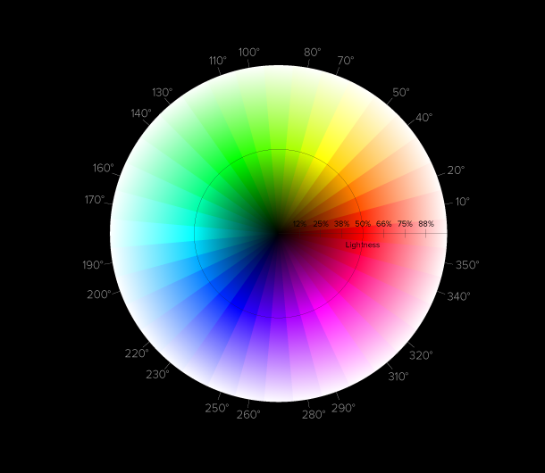

HSLA Colors
HSLA allows a fourth value, which sets the Opacity (via the Alpha channel) of the element.
As RGBA is to RGB, HSLA is to HSL
Supported in IE9+, Firefox 3+, Chrome, Safari, and in Opera 10+
Example:
hsla(0, 100%, 50%, 0.5)
Result:

Slide 27

CSS 3 Colors
Live Demo

Slide 28

Backgrounds

Slide 29

Gradient Backgrounds
Gradients are smooth transitions between two or more specified colors
Use of CSS gradients can replace images and reduce download time
Create a more flexible layout, and look better while zooming
Supported in all major browsers via different keywords
This is still an experimental feature

Slide 30

Gradient Backgrounds Example
/* Firefox 3.6+ */
background: -moz-linear-gradient(100% 100% 90deg,
#FFFF00, #0000FF);
/* Safari 4-5, Chrome 1-9 */
background: -webkit-gradient(linear, 0% 0%, 0%
100%, from(#0000FF), to(#FFFF00));
/* Safari 5.1+, Chrome 10+ */
background: -webkit-linear-gradient(#FFFF00,
#0000FF);
/* Opera 11.10+ */
background: -o-linear-gradient(#2F2727, #0000FF);

Slide 31



Multiple Backgrounds
CSS3 allows multiple background images
Simple comma-separated list of images
Supported in Firefox (3.6+), Chrome (1.0/1.3+), Opera (10.5+) and Internet Explorer (9.0+)
Comma separated list for the other properties
background-image: url(sheep.png), url(grass.png);

Slide 32

Backgrounds
Live Demo

Slide 33
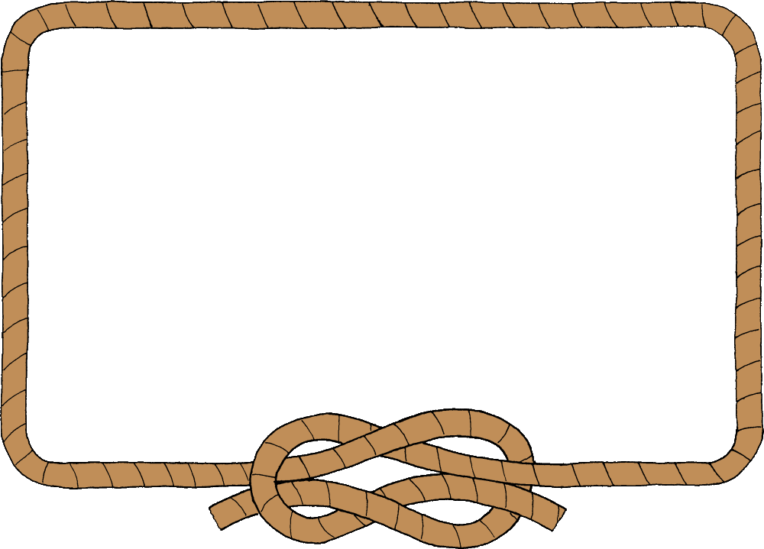
Borders

Slide 34
Border color
Allows you to create cool colored borders
Only Firefox supports this type of coloring
border: 8px solid #000; -moz-border-bottom-colors: #555 #666 #777 #888 #999 #aaa #bbb #ccc; -moz-border-top-colors: #555 #666 #777 #888 #999 #aaa #bbb #ccc; -moz-border-left-colors: #555 #666 #777 #888 #999 #aaa #bbb #ccc; -moz-border-right-colors: #555 #666 #777 #888 #999 #aaa #bbb #ccc;

Slide 35
Border image
Defines an image to be used instead of the normal border of an element
Split up into a couple of properties
Example:
The border-image property has 3 parts:
More detailed description:
http://css-tricks.com/6883-understanding-border-image/
border-image: url(border-image.png) 25% repeat;

Slide 36

Border radius
Allows web developers to easily utilize rounded corners in their design elements
Widespread browser support
Syntax:
Example:
border-*-*-radius: [<length>|<%>][<length>|<%>]?
-moz-border-radius: 15px; border-radius: 15px;
background-color: #FF00FF;

Slide 37

Box shadow
Allows to easily implement multiple drop shadows (outer or inner) on box elements
Specifying values for color, size, blur and offset
Example:
-moz-box-shadow: 10px 10px 5px #888; -webkit-box-shadow: 10px 10px 5px #888; box-shadow: 10px 10px 5px #888;

Slide 38

Borders
Live Demo

Slide 39
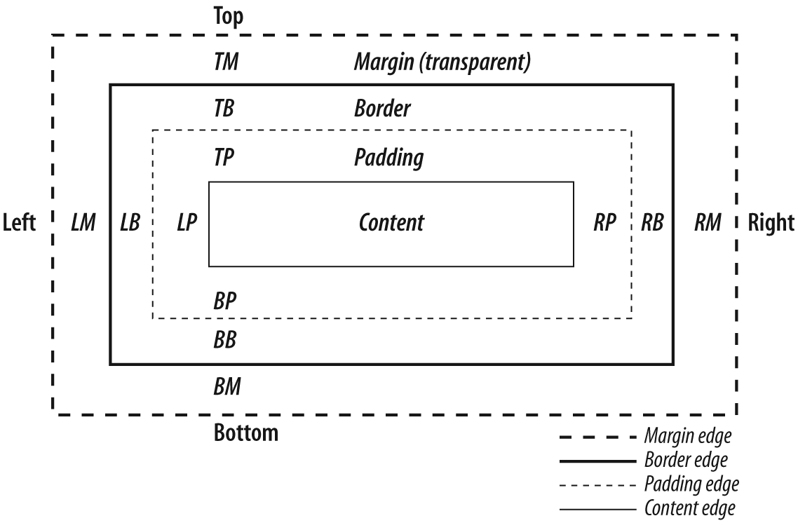
Box Model

Slide 40
CSS3 box-sizing
Determine whether you want an element to render it's borders and padding within its specified width, or outside of it.
Possible values:
box-sizing: content-box (default) box width: 278 pixels + 10 pixels padding and 1 pixel border on each side = 300 pixels
box-sizing: border-box box width: 300 pixels, including padding and borders

Slide 41
CSS3 box-sizing (Example)
Example: Box with total width of 300 px (including paddings and borders)
width: 300px;
border: 1px solid black;
padding: 5px;
/* Firefox */
-moz-box-sizing: border-box;
/* WebKit */
-webkit-box-sizing: border-box;
/* Opera 9.5+, Google Chrome */
box-sizing: border-box;

Slide 42
CSS 3 Flexible Box Model
The flexible box model determines the way boxes are distributed inside other boxes and the way they share the available space.
New values for "display" property:
flexbox
inline-flexbox
This box model is still under development
Still not supported in major browsers

Slide 43
CSS 3 Box Model Properties
flex-direction
Specifies how flexbox items are placed
flex-order
May be used to change the ordering of the elements. Elements are sorted by this value.
flex-pack
Defines the flexibility of packing spaces
flex-align
Changes the way free space is allocated

Slide 44
CSS 3 flex-direction
The flex-direction property specifies how flexbox items are placed in the flexbox.
Possible values:
lr – Displays elements from left to right
rl – Displays elements from right to left
tb – Displays elements from top to bottom
bt – Displays elements from bottom to top
inline and inline-reverse
block and block-reverse

Slide 45

Box Model
Live Demo

Slide 46

Animations

Slide 47
Animations
Works in all webkit browsers
Example:
@keyframes resize {
0% {...}
50% {...}
100% {...}
}
#box {
animation-name: resize;
animation-duration: 1s;
animation-iteration-count: 4;
animation-direction: alternate; animation-timing-function: ease-in-out;
}

Slide 48
Transitions
Add an effect when changing from one style to another
Different timing functions:
ease, ease-in, ease-out, ease-in-out, linear
Example:
#id_of_element {
-webkit-transition: all 1s ease-in-out; -moz-transition: all 1s ease-in-out;
-o-transition: all 1s ease-in-out;
-ms-transition: all 1s ease-in-out; transition: all 1s ease-in-out;
}

Slide 49
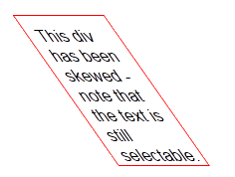
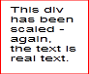
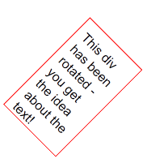
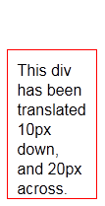
2D Transformations
2D transforms are widely supported
Skew – skew element
transform: skew(35deg);
Scale – scale element
transform: scale(1,0.5);
Rotate – rotates element
transform: rotate(45deg);
Translate – moves element
transform: translate(10px, 20px);

Slide 50

3D Transformations
3D transforms are similar to 2D transforms
Only work in Safari and Chrome
X, Y and Z transformation
transform: rotateX(180deg);
transform: rotateY(180deg);
transform: rotateZ(180deg);
perspective: 800;
perspective-origin: 50% 100px;
translate3d, scale3d

Slide 51

Animations
Live Demo

Slide 52
CSS 3
?
?
?
?
?
Questions?
?
?
?
?
?
?

Slide 53
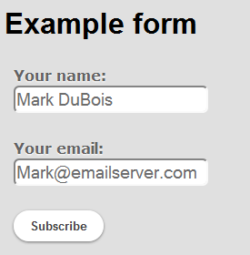
Homework
Using your knowledge of CSS 3 style the given HTML code and approximate the end result (shown in the image below:
<div id="example_form">
<h1>Example form</h1>
Your name:
<input value="Mark DuBois"/>
Your email:
<input value="Mark@...." />
<input value="Subscribe" type="submit" />
</div>

Slide 54

Homework (2)
Using CSS3 make a rotating 3D Rubik Cube.
Using CSS3 make a text that is pulsing, i.e. gets bigger, then smaller, etc. while blinking with different colors.
Using CSS3 make a text bouncing around the screen (the browser).
Hint: the text should change its position

Slide 55

Homework (3)
Using CSS3 make a landscape with a lake/sea with ships moving in it.

